Slide 1


Quantum Reservoir Computing

Slide 2

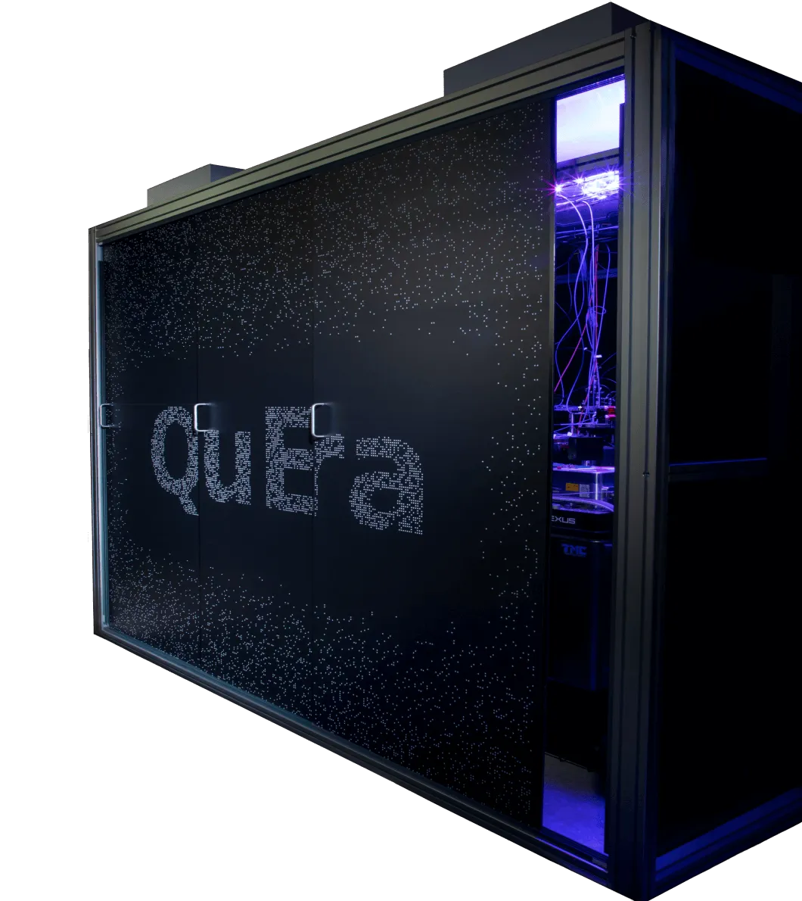
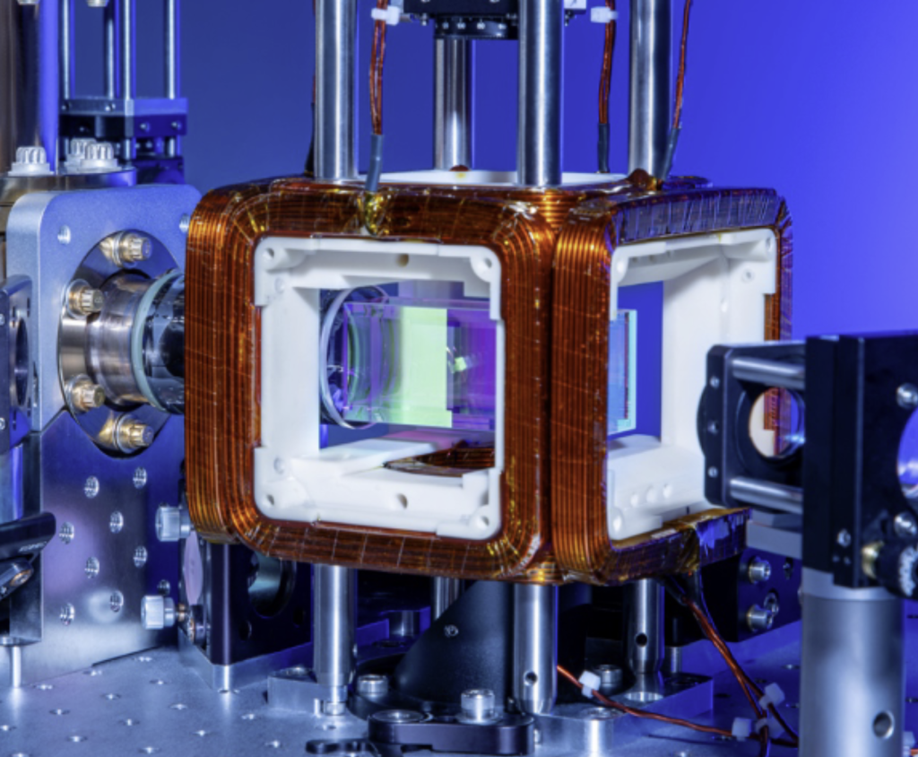

Slide 3
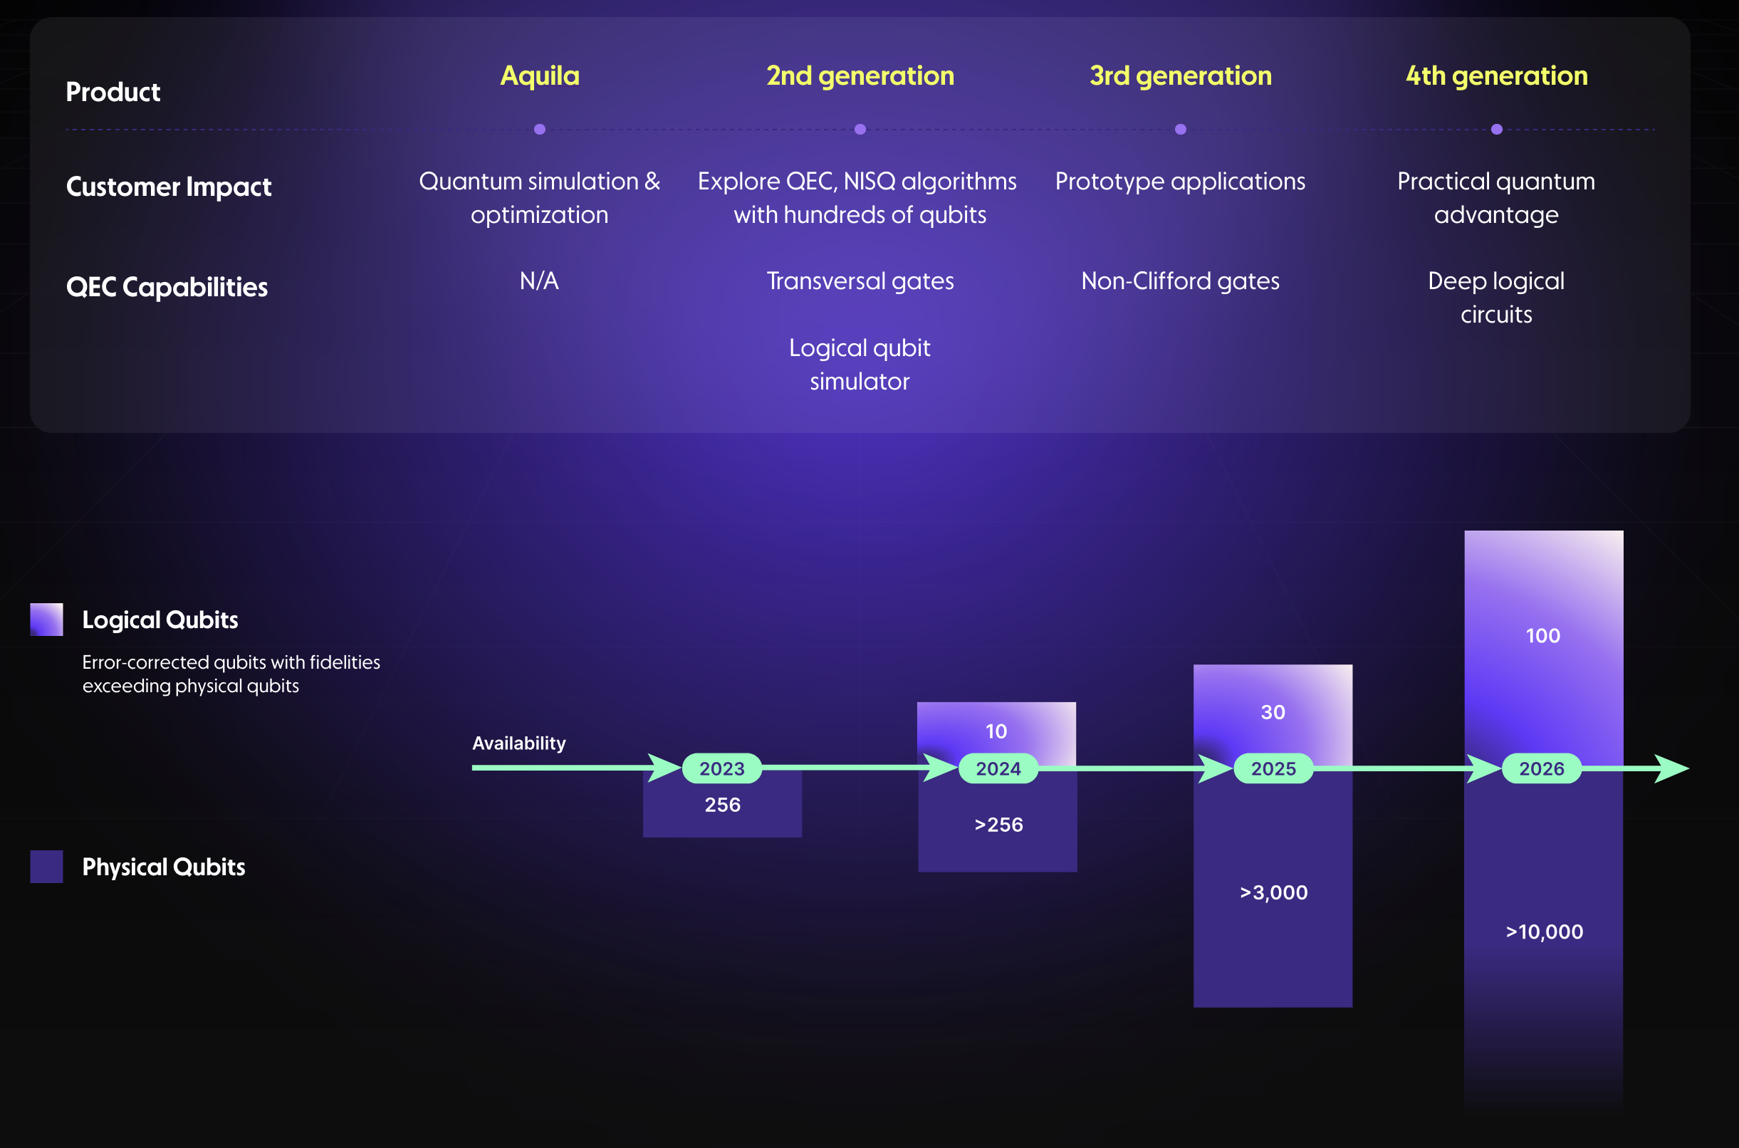

Slide 4
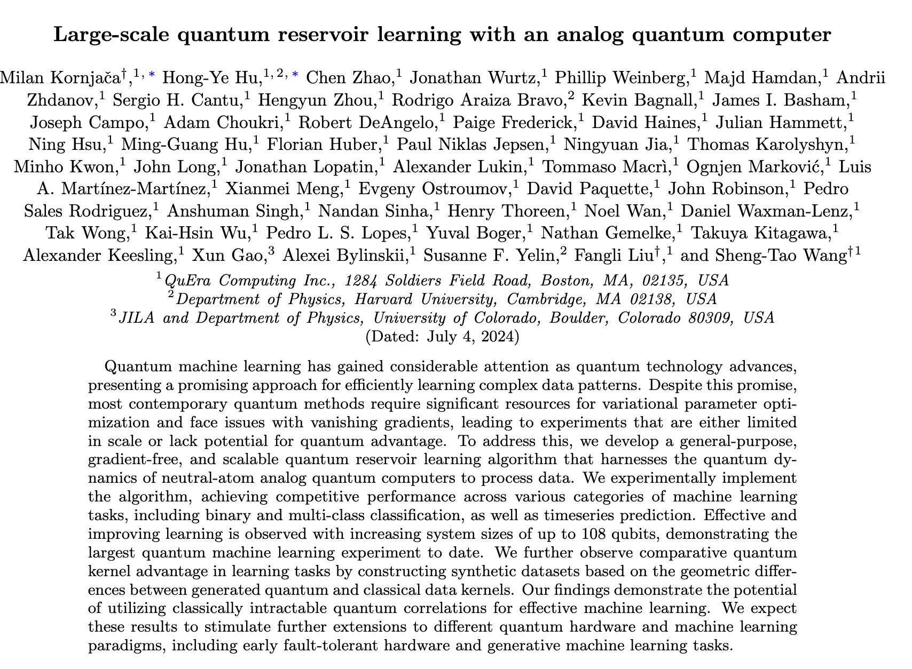
Quantum Reservoir Computing

Slide 5
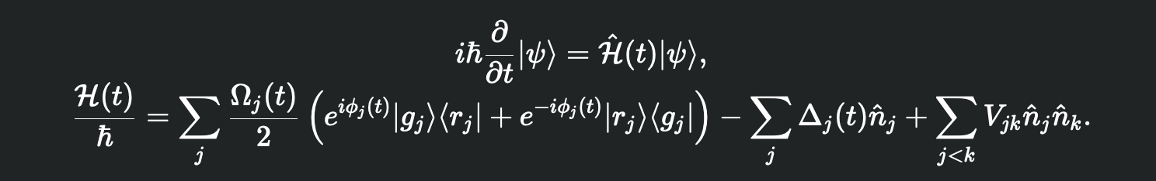
Quantum Reservoir Computing

Slide 6
Quantum Reservoir Computing
- specify atom positions
- program waveforms of Hamiltonian parameter
- create the Hamiltonian
- specify the initial state
- emulation
- measure

Slide 7
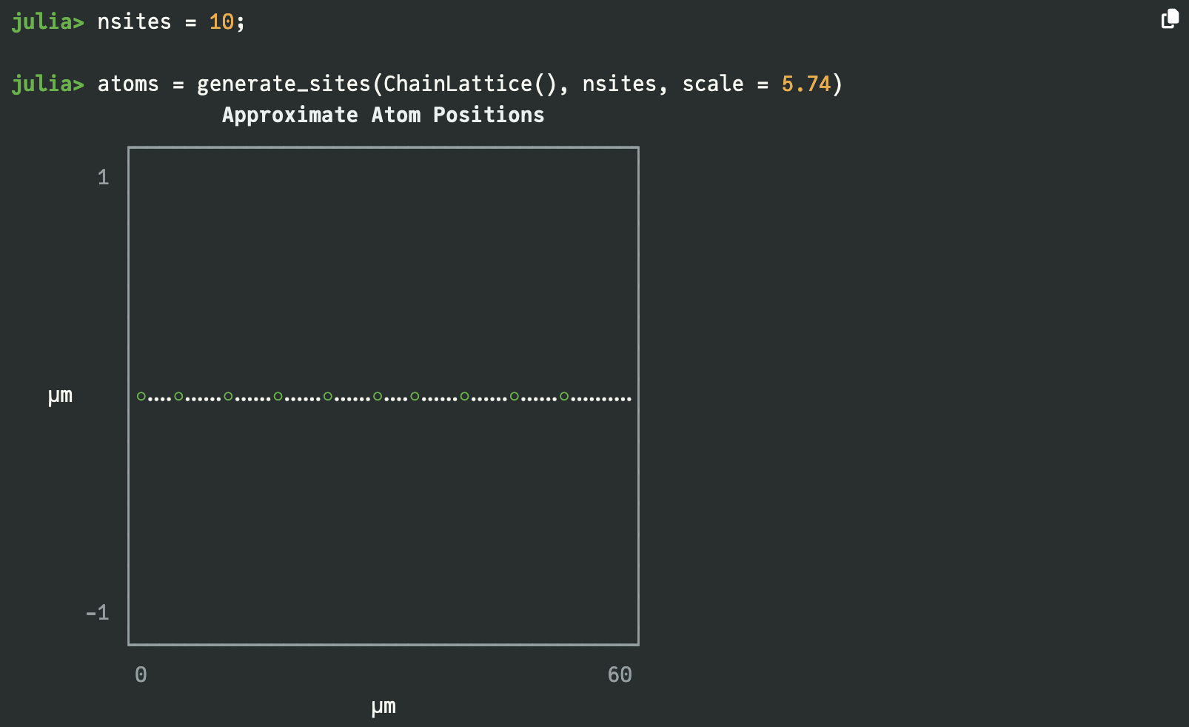
Quantum Reservoir Computing

Slide 8
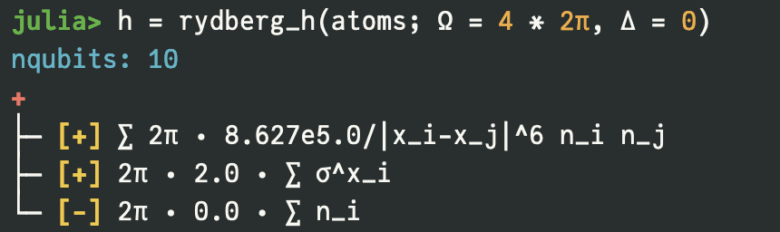
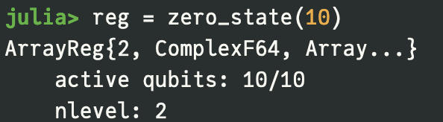
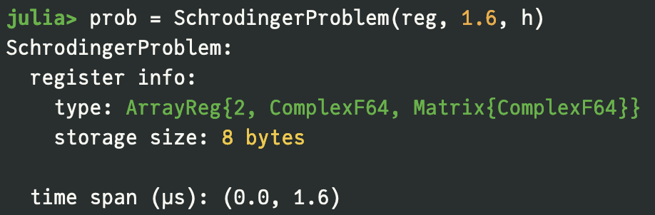
Quantum Reservoir Computing

Slide 9
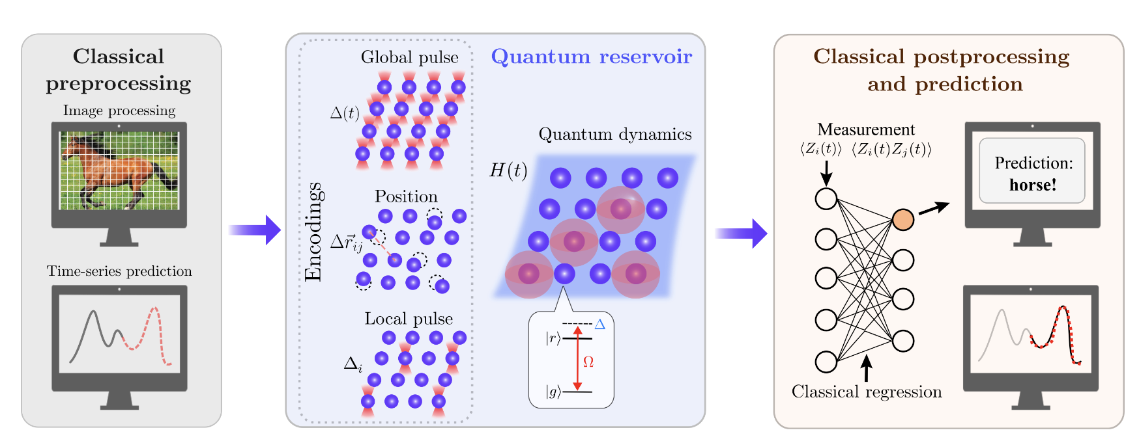
Quantum Reservoir Computing

Slide 10
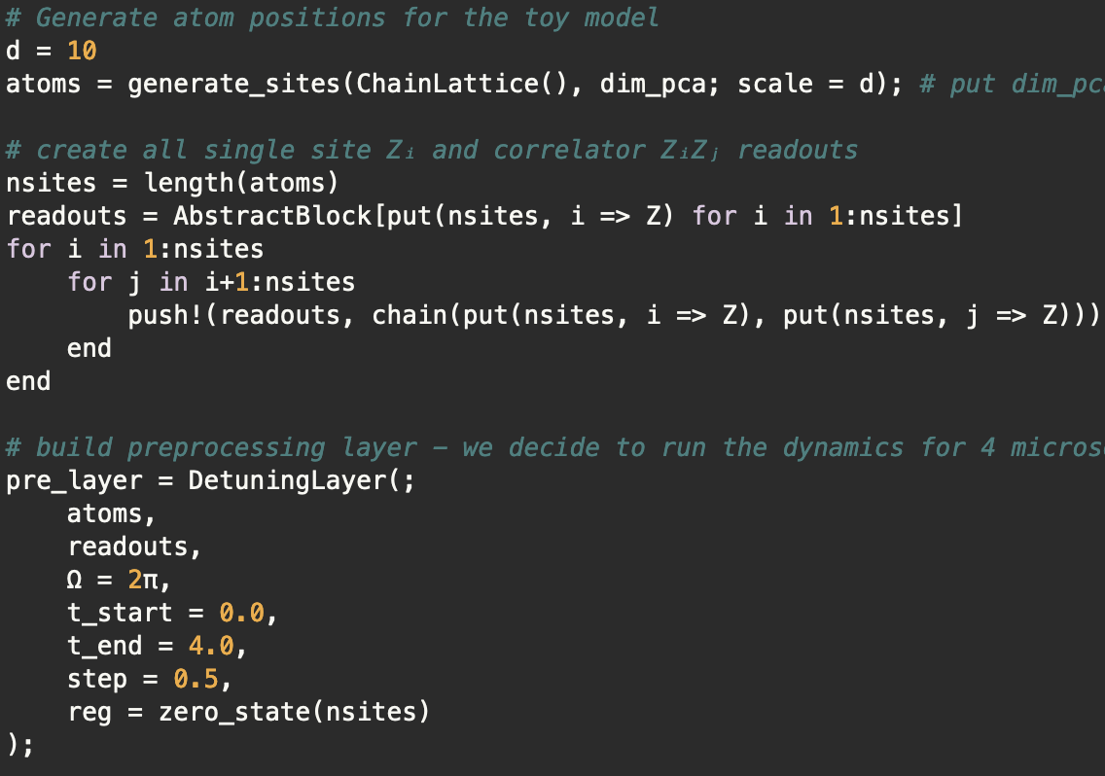
Quantum Reservoir Computing

Slide 11
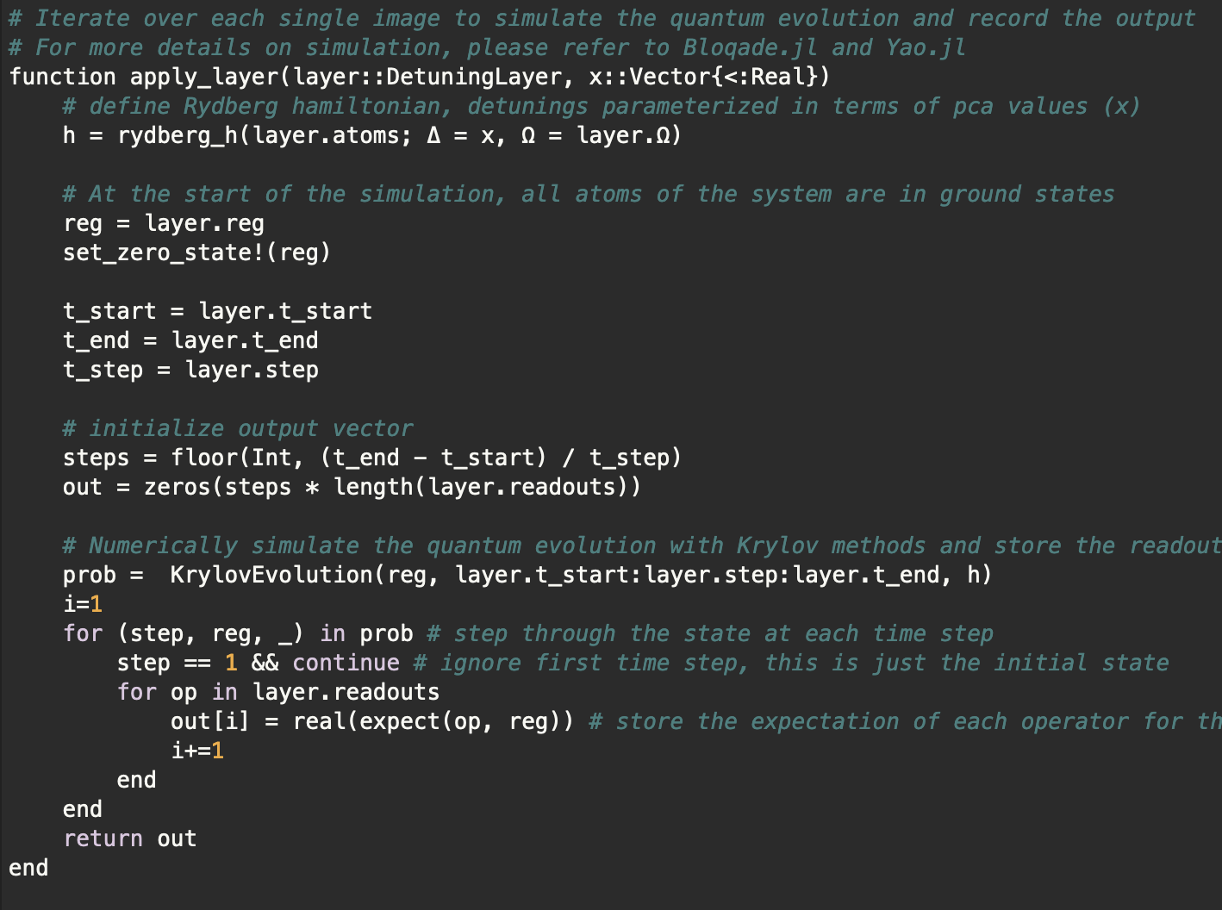
Quantum Reservoir Computing

Slide 12
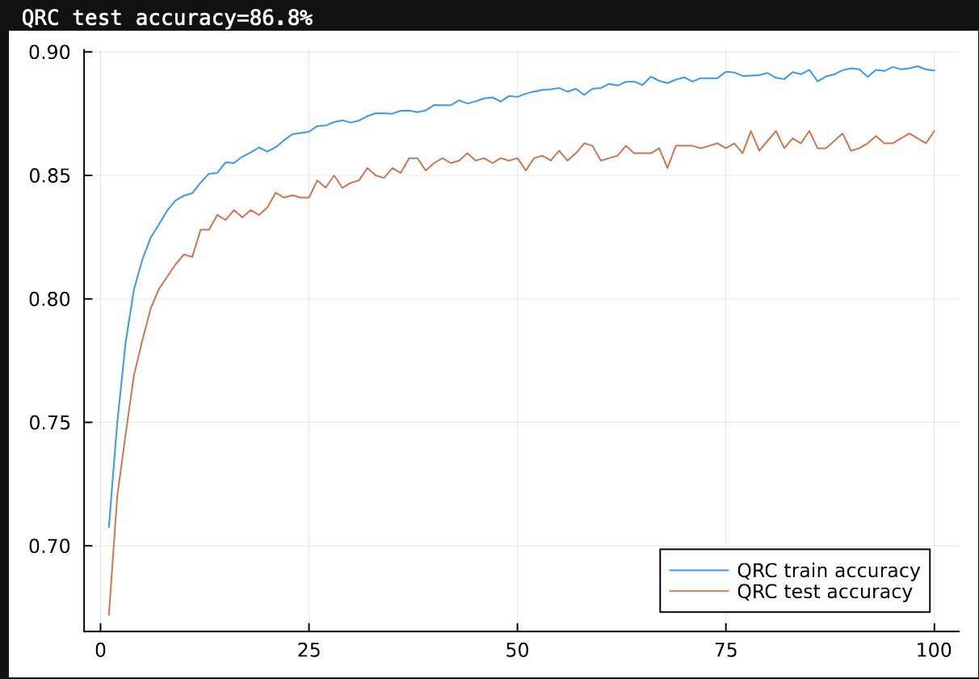
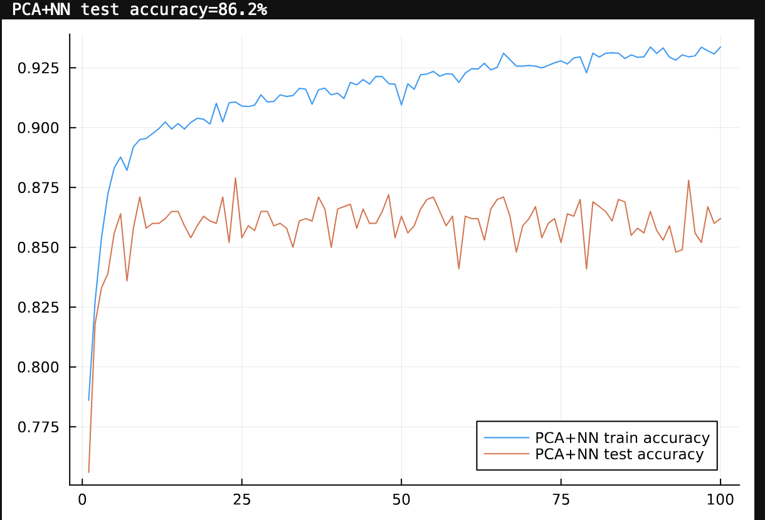
Quantum Reservoir Computing

Slide 13
Quantum Reservoir Computing
There is more!

Slide 14
Quantum Binary Classification based on QRC

Slide 15
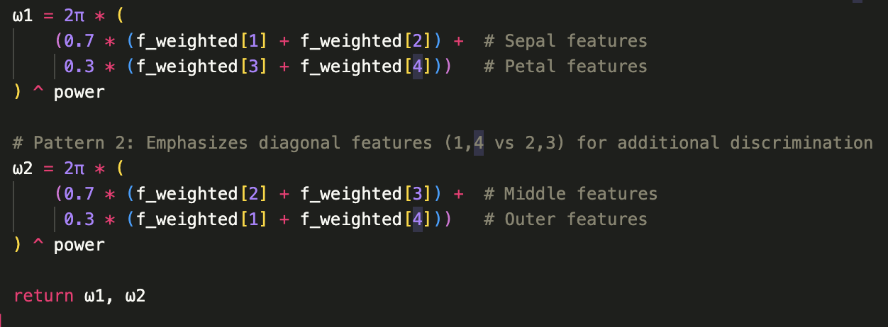
Quantum Reservoir Computing

Slide 16
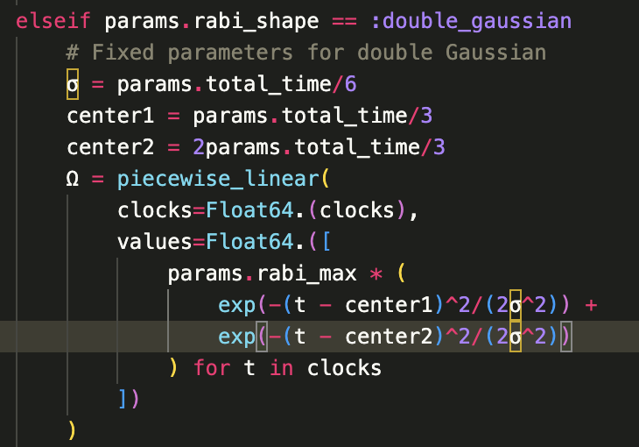
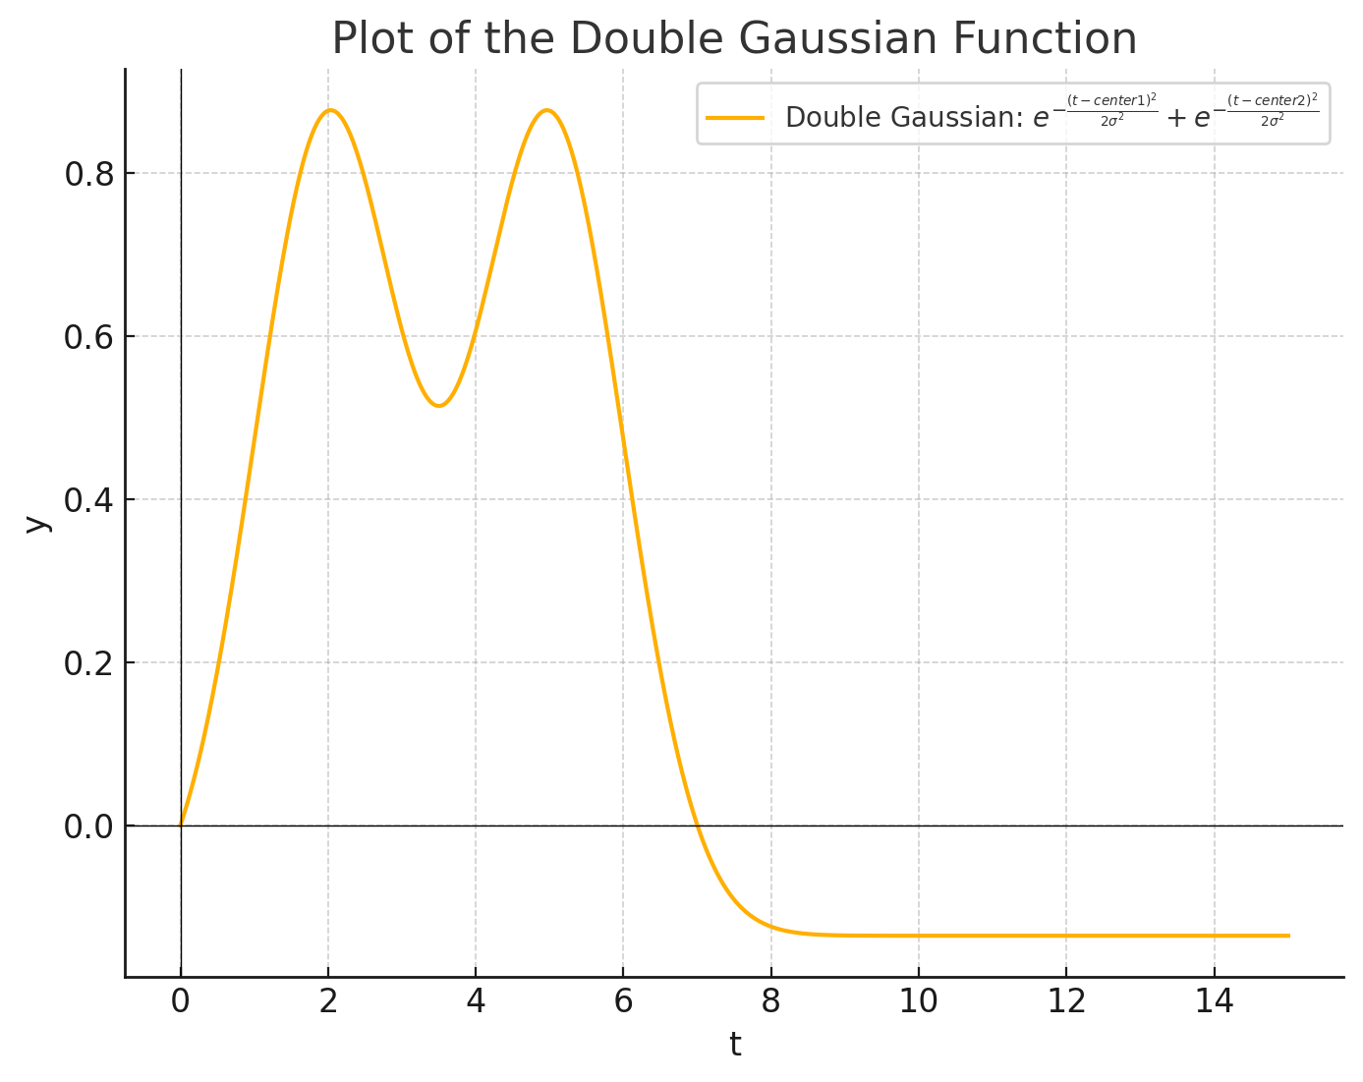
Quantum Reservoir Computing

Slide 17
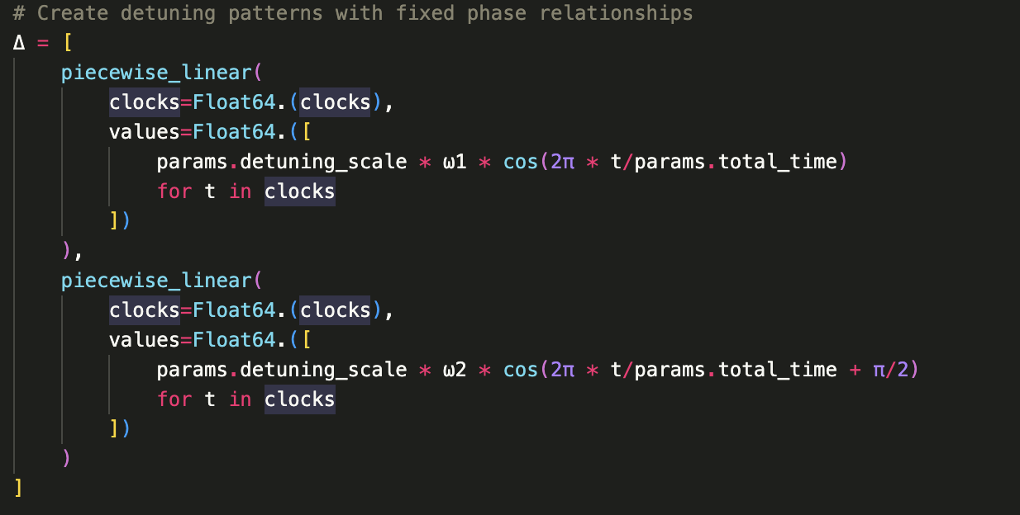
Quantum Reservoir Computing

Slide 18
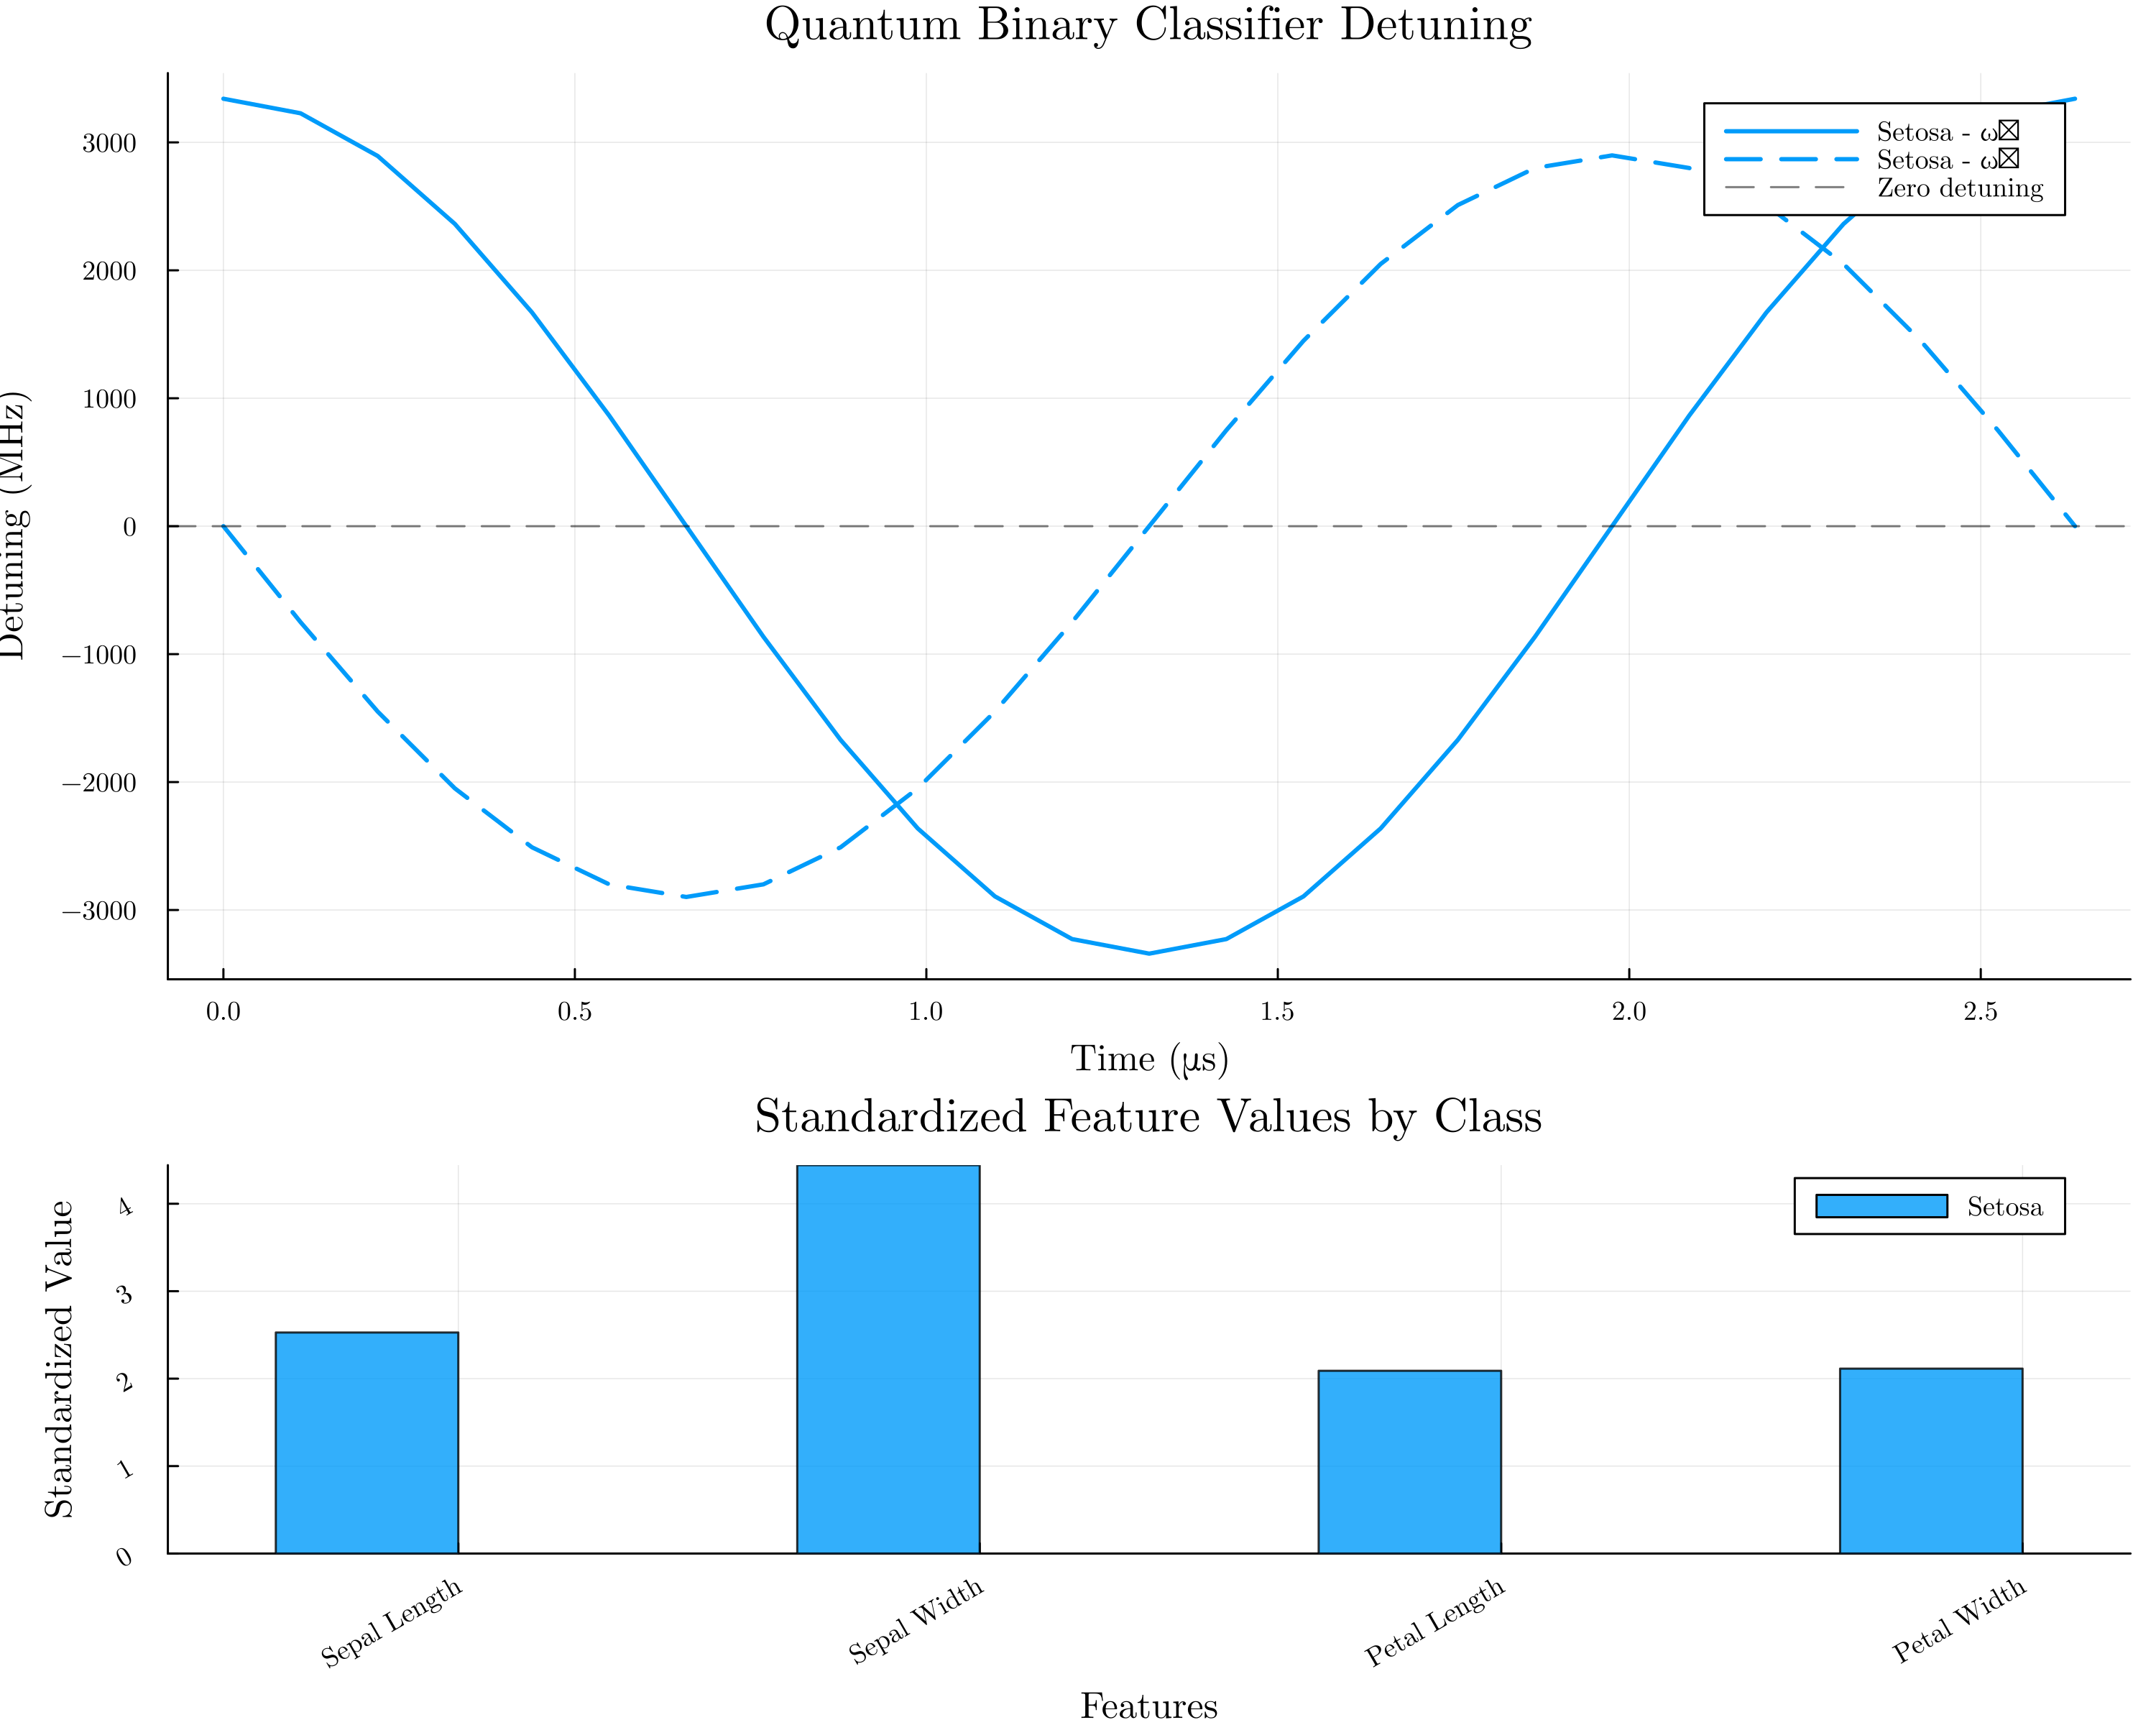
Quantum Reservoir Computing

Slide 19
Quantum Reservoir Computing
Final Results:
Best balanced accuracy: 82.5%
Best F1 score: 76.19%
Best configuration: Geometry: linear
Rabi shape: double_gaussian
Atom scale: 9.161911432395819

